Slide 1

NLP Sentiment Analysis
Group-5
Project Title :
Excelr Solutions, Bangalore
Date;17-Nov-2025

Slide 2
Group-5
NLP Sentiment Analysis :
Sentiment Analysis is a Natural Language Processing (NLP) technique used to identify, extract, and classify the emotional tone or opinion expressed in text data.
Business Objective :
Extracting sentiment from customer reviews on a product

Slide 3

Project Objective :
Group-5
Identify sentiment as Positive, Neutral, or Negative
Build and train a machine learning classification model
Improve accuracy through effective preprocessing and tuning
Deploy the model for real-time predictions .

Slide 4
Dataset Overview:
Group-5
Feature | Description
Total Records | 1,440
Columns | title, body, rating.
Rating Distribution | Rating 1:386 Rating 2:126 Rating 3: 199 Rating 4:310 Rating 5:419
Data Types | Text + Numeric
Observation | Dataset is moderately imbalanced

Slide 5
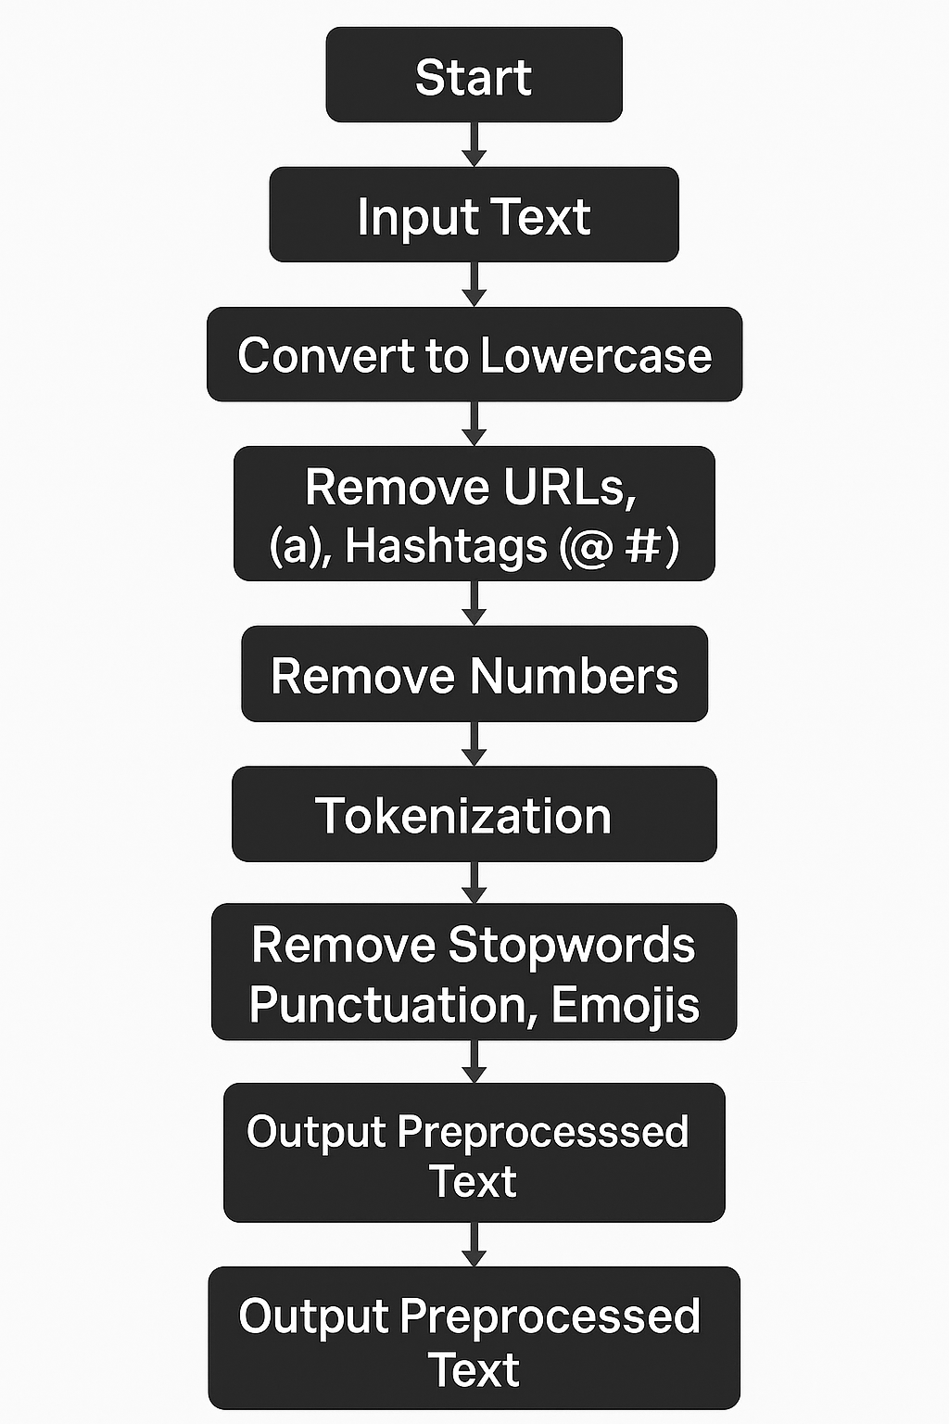
Data Preprocessing:
Group-5
Text Translation
Other Languages
English
Performed language translation to maintain consistency across reviews.
Converted text to lowercase for uniformity.
Removed URLs, mentions, hashtags, numbers, and punctuation.
Removed emojis and cleaned extra whitespace.
Performed tokenization and removed English stopwords.
Applied lemmatization to reduce words to their base form.
Final output: clean and normalized text for model training.
Text Cleaning

Slide 6
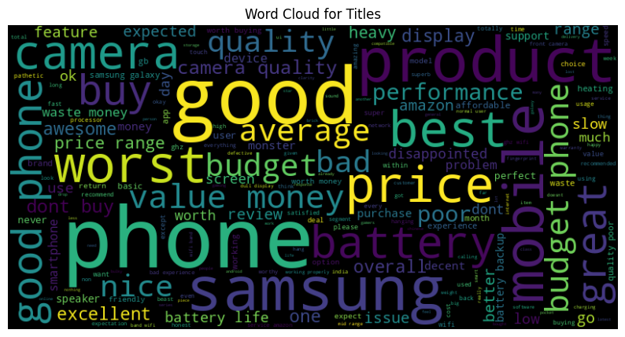
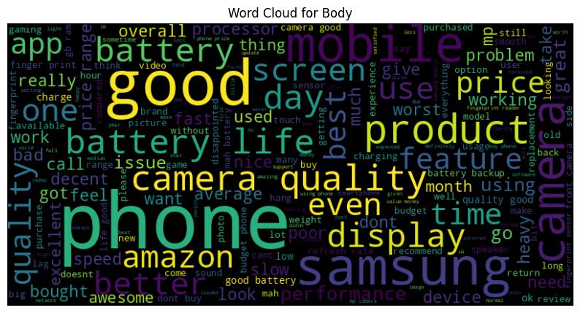
Exploration Data Analysis:
Group-5
Sentiment distribution shows more Positive reviews, followed by Negative and Neutral.
Rating distribution is polarized, with many 1-star and 5-star reviews.
Word clouds highlight common terms like phone, good, camera, price, battery.
Insights show users focus mainly on quality, performance, and value for money.

Slide 7
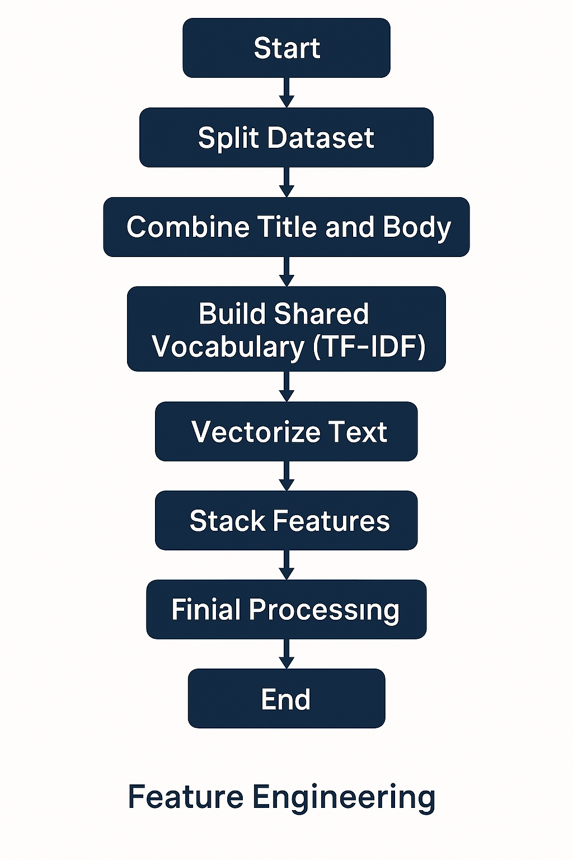

Feature Engineering :
Group-5
Separate TF-IDF vectorizers applied to title and body for better feature extraction from each text field.
Uses 1–3 gram patterns (unigrams, bigrams, trigrams) to capture important phrases, not just single words.
Feature limits (10k for title, 15k for body) prevent huge dimensionality and reduce memory usage.
ColumnTransformer applies each vectorizer to the correct column, keeping preprocessing structured and scalable.
Outputs a combined sparse feature matrix, ready for machine learning models.

Slide 8
Model Building :
Group-5
*Models Tried
Tried Random Forest, SVM, and XGBoost.
XGBoost delivered the best accuracy (78%).
Handles imbalanced data more effectively.
Used TF-IDF for text feature extraction.
Applied oversampling during training.
Chose XGBoost due to highest accuracy and stable performance.
XGBoost,SVM,Random Forest
*Model Selected
XGBoost Model

Slide 9
PipeLining Creation:
Group-5
Define Text Cleaner
Define Preprocessor
Built an end-to-end ML pipeline combining Text Cleaner, TF-IDF feature extraction and the XGBoost classifier.
The pipeline automatically handles text vectorization, feature transformation, and prediction.
Trained the model on preprocessed training data for sentiment classification.
Achieved optimized performance after tuning hyperparameters.
Saved the final trained pipeline as a .joblib file for deployment and real-time prediction.
Build XGBoost Classifier
Create Pipeline
Train Pipeline
Test Predictions

Slide 10
Model Deployment:
Group-5
Created an app.py file to load the saved model.joblib and run predictions.
Integrated the pipeline model inside a Streamlit UI for real-time sentiment analysis.
Configured Streamlit components for text input and displaying prediction results.
Used ngrok authentication to generate a secure public URL for hosting the app.
Deployed the Streamlit application using ngrok, making it accessible online.

Slide 11
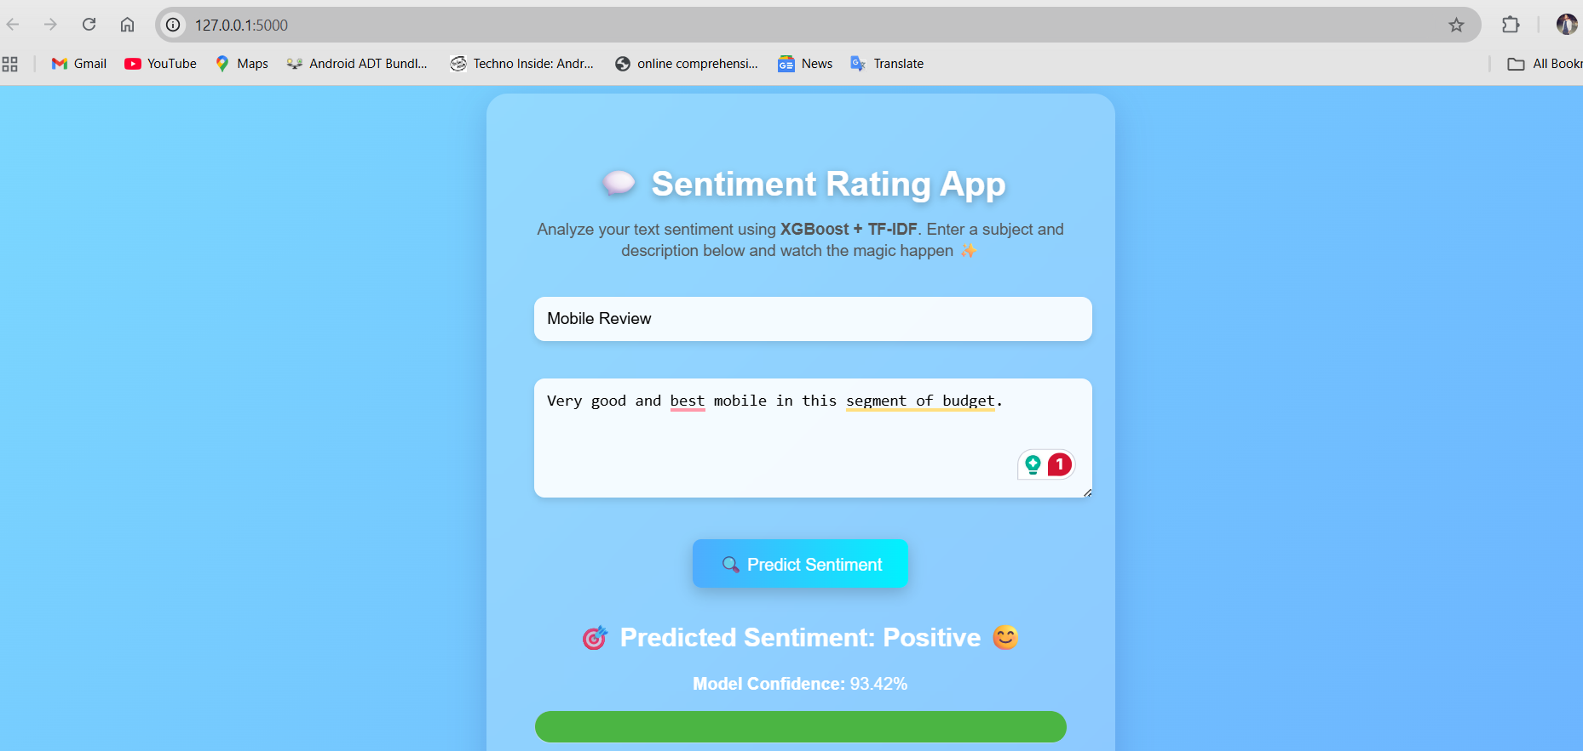
Prediction Result Screenshot

Slide 12

Challenges Faced:
Group-5
Language Translation Inconsistency:
Translated text still appeared as non-English due to mixed characters, slang, and partial translations.
Severe Class Imbalance:
The Neutral class had very few samples, resulting in significantly low recall and weaker learning.
Sentiment Leakage Across Title & Body:
Both fields contained sentiment words, causing the model to depend on sentiment appearing in both.
Deployment Issues with Ngrok:
Multiple tunnel conflicts caused frequent errors, forcing a switch from Streamlit+Ngrok to Flask.
High Feature Dimensionality:
TF-IDF with n-grams produced a huge feature space, increasing memory usage and slowing model training.

Slide 13

Thank you
Group-5

